Slide 1
TEVET Codes of Conduct and Orientation Materials Roll Out
19th December 2018

Slide 2
College Packs (For Staff and Display in the College)

Slide 3
Orientation Programme Guide A4 booklet
English only
2-30 per collage (depending on size)
To be used by college staff running the orientation programme

Slide 4
Instructor and Administration Staff Code of Conduct A4 booklet
English only
1 per Instructor / Admin staff
1 copy to be kept in administration office

Slide 5
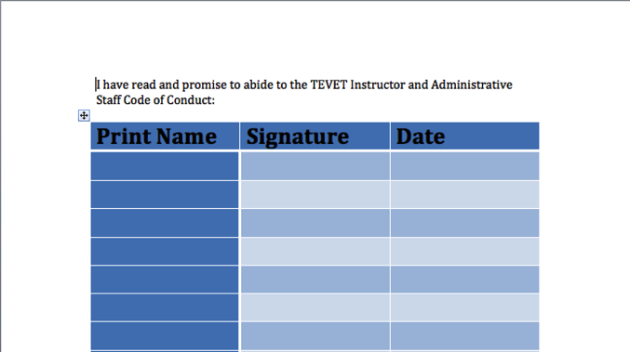
Staff Code of Conduct Sign Sheet
All Instructors and Administration staff to read the Code of Conduct document and sign this sheet
Sheet to be retained by college administration office

Slide 6
Staff Code of Conduct A2 Poster
In English, Chichewa and Tumbuka
1-3 English and 1-3 Local language per college
Place in prominent locations, e.g. entrance hall, notice board, assembly room

Slide 7
Trainee Code of Conduct A2 Poster
In English, Chichewa and Tumbuka
1 English and 1 Local language per each college classroom

Slide 8
Role Model A2 Poster
In English, Chichewa and Tumbuka
1-3 English and 1-3 Local language per college
Place in prominent locations, e.g. entrance hall, notice board, assembly room

Slide 9
Infographic A2 Poster
In English, Chichewa and Tumbuka
1-3 English and 1-3 Local language per college
Place in prominent locations, e.g. entrance hall, notice board, assembly room

Slide 10
Equality A2 Poster
A2 Poster
In English, Chichewa and Tumbuka
1-3 English and 1-3 Local language per college
Place in prominent locations, e.g. entrance hall, notice board, assembly room

Slide 11
Sexual Violence A2 Poster
A2 Poster
In English, Chichewa and Tumbuka
1-3 English and 1-3 Local language per college
Place in prominent locations, e.g. entrance hall, notice board, assembly room

Slide 12
College Packs
Chichewa and Tumbuka versions of the college packs
Central and Southern colleges to receive English and Chichewa versions
Northern colleges to receive English & Tumbuka versions (a few colleges with more Chichewa speakers to receive a few additional Chichewa versions)
Material | Size | English | Chichewa | Tumbuka
Instructor Code of Conduct | A4 | x
Orientation program | A4 | x
Trainee Code of Conduct Poster | A2 | x | x | x
Staff code of conduct poster | A2 | x | x | x
Equality poster | A2 | x | x | x
Sexual Violence poster | A2 | x | x | x
Role model poster | A2 | x | x | x
Infographic Poster | A2 | x | x | x

Slide 13
College Packs: Distribution Instructions
College administration to put posters up in the colleges / classrooms as soon as possible
College principal to share the orientation programme with staff members selected to run the orientation
All staff to receive 1 copy of the instructor and administration staff code of conduct each
All staff to sign the Code of Conduct sign sheet
College administration to retain the staff Code of Conduct sign sheet
Trade test centers to receive posters only

Slide 14
Trainee Packs

Slide 15
Trainee Code of Conduct A4 booklet
Most in English
A limited number in Chichewa and Tumbuka (for colleges where trainees mostly use local language)
1 per new trainee
For returning trainees if supplies allow
Included in trainee starter pack bag
1 copy to be kept in administration office

Slide 16
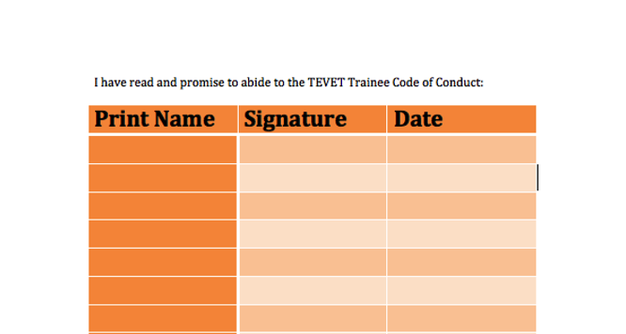
Trainee Code of Conduct Sign Sheet
All Trainees to read the Code of Conduct document and sign this sheet
Sheet to be retained by college administration office

Slide 17
Trainee Code of Conduct Folded Pamphlet
English on one side and local language on the other
Tumbuka versions in the North, Chichewa versions in Central and South
1 per new trainee
For returning trainees if supplies allow
Included in trainee starter pack bag
1 copy to be kept in administration office

Slide 18
Orientation Manual A4 booklet
In Chichewa and Tumbuka (no English)
1 per new trainee
For returning trainees if supplies allow
Included in trainee starter pack bag
1 copy to be kept in administration office

Slide 19
Sexual violence folded pamphlet
English on one side and local language on the other
Tumbuka versions in the North, Chichewa versions in Central and South
1 per new trainee
For returning trainees if supplies allow
Included in trainee starter pack bag
1 copy to be kept in administration office

Slide 20
Role Model A5 Booklet
English on one side and local language on the other
Tumbuka versions in the North, Chichewa versions in Central and South
1 per new trainee
For returning trainees if supplies allow
Included in trainee starter pack bag
1 copy to be kept in administration office

Slide 21
A5 Family Booklet
Chichewa and Tumbuka versions
Tumbuka versions in the North, Chichewa versions in Central and South
1 per new trainee
For returning trainees if supplies allow
Included in trainee starter pack bag
For Trainees to take home to their family/community
Soft copies supplied for trainees to send to them families via whatsapp/email

Slide 22
Trainee Orientation Packs
Chichewa and Tumbuka versions of the trainee packs
Central and Southern colleges to receive English and Chichewa versions
Northern colleges to receive a mix of English, Chichewa and Tumbuka versions
Material | Size | English | Chichewa | Tumbuka | English + Chichewa | English + Tumbuka
Bags | N/A
Trainee Code of Conduct | A4 | x | x | x
Trainee orientation manual | A4 |  | x | x
Family booklet | A5 |  | x | x
Trainee Code of Conduct pamphlet | Pamphlet |  |  |  | x | x
Sexual violence pamphlet | Pamphlet |  |  |  | x | x
Role model booklet | A5 |  |  |  | x | x

Slide 23
Trainee Packs: Distribution Instructions
All 1 year trainees to receive 1 copy of the trainee pack each
College to distribute trainee packs to trainees as soon as possible
Minimum 1 copy of the trainee pack to be kept in the college administration office
Any spare trainee packs can be shared with 2nd & 3rd year trainees (if applicable) or retained for future trainees
All trainees to sign the Code of Conduct sign sheet
College administration to retain the trainee Code of Conduct sign sheet

Slide 24
Delivery
Hard copies for government colleges (All collages will receive soft copies. Private colleges can print if they wish)
Planned for 1st or 2nd week of January 2019
Delivery from Capital Printers. They will call the Principal to arrange delivery
Please ensure someone is at the college to accept delivery

